Slide 1
Customer segmentation using K-Means
Presented by Team Customer segmentation

Slide 2
Agenda:
Introduction
Customer segmentation
Exploratory Data Analysis
Data Pre-processing
K-means clustering Development
Conclusion

Slide 3

Customer Segmentation
Some real time examples
Customer segmentation
Amazon
Flipkart/Walmart
Food recommendations
All most all product-based companies
1
Customer segmentation is a process by which we divide customers into segments or groups based on demographics or behaviors, So we can market to those customers more effectively.
3
4
Customer segmentation findings
Customer needs: Needs are the customers motivation on to buy any product or service
Customer Behavior: Behavior, like purchase frequency and transaction size, helps us understand the market dynamics and how far we have come
Customer Demographics: Demographics and socio-demographics help us describe the target customer group(s) in general terms
2
Customer segmentation is required ?
Customer segmentation will help us to understand about the customer in better way and meet their unique needs. By enabling customer segmentation:
Retention rate can be maximized
Customer experience can be improved
Marketing costs can be reduced.
Marketing campaigns(Email marketing, SMS, Facebook ads)

Slide 4
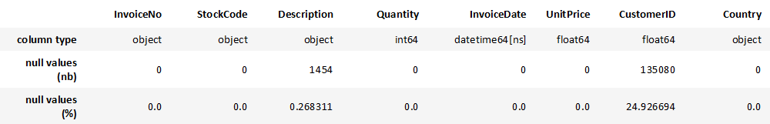
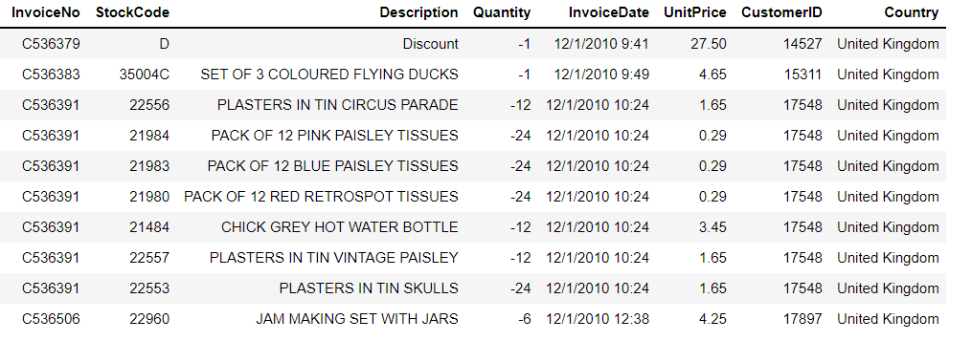
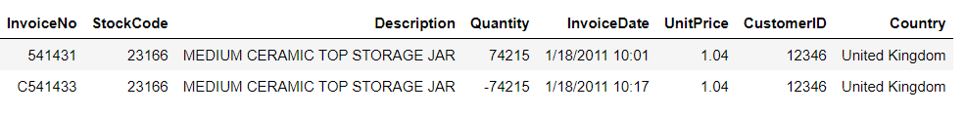
Exploratory Data Analysis
Data Source: https://archive.ics.uci.edu/ml/datasets/online+retail
Data is Unlabeled set
Data Contains 500000+ Rows and 8 variables
It contains 37 unique countries.
Majority of Customers are from UK region.
Based on the transactions 70 percent of the revenue is from UK followed by Netherlands
In some cases, stock code starts with D and they are offered under discount.
There are few invoices starts with “C”, those transactions were cancelled.
16.46% of orders were cancelled in the dataset.

Slide 5
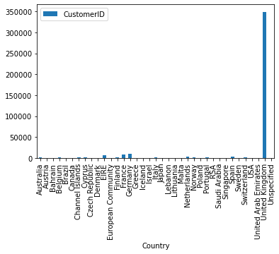
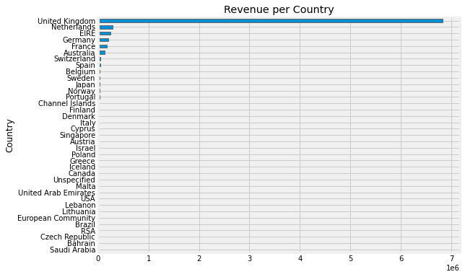
Based on the transactions, 70 percent of the revenue is from the UK region followed by the Netherlands and most of the customers are from UK region.

Slide 6
Data variables in a data set
Independent variables in dataset:
Invoice no
Stock code
Description
Quantity
Invoice date
Unit price
Customer
Country

Slide 7
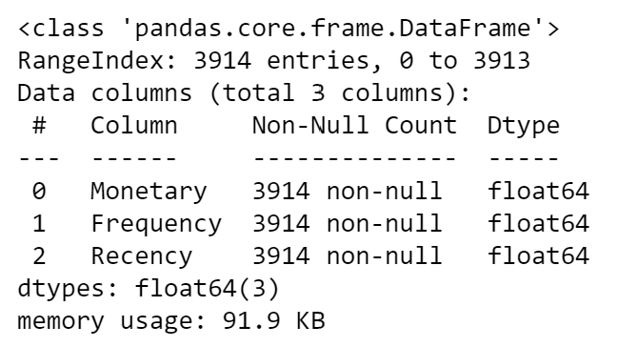
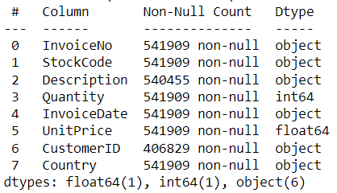
Data Pre-processing
Importing all the required libraries
Checking the columns data and data type
Removing Duplicate values, Null Values.
Removing cancelled orders
Creating Total purchase using Quantity*Unit Price.
Frequency of the purchase
Last purchase
K-means is very sensitive to outliers and noisy data
Removing the outliers

Slide 8
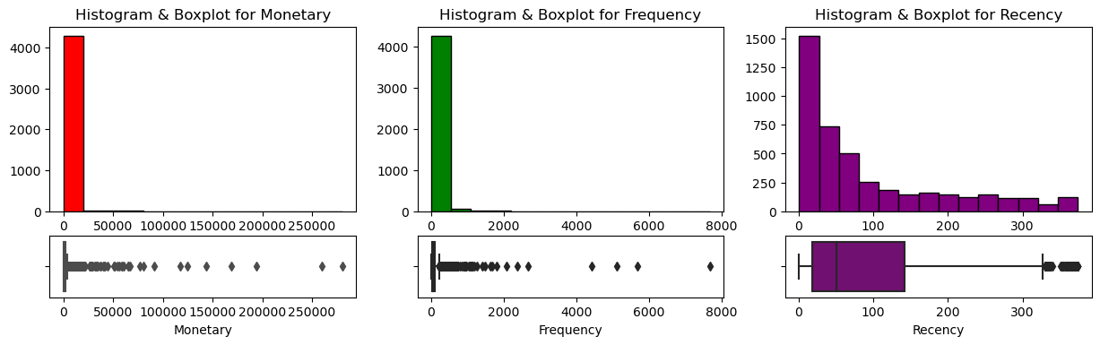
RFM metrics of the dataset.
Below are the histograms for key metrics: Recency, Frequency and Monetary
1. Recency: How recently a customer has made a purchase.
2. Frequency: How often a customer makes a purchase.
3. Monetary Value: How much money a customer spends on purchases.

Slide 9
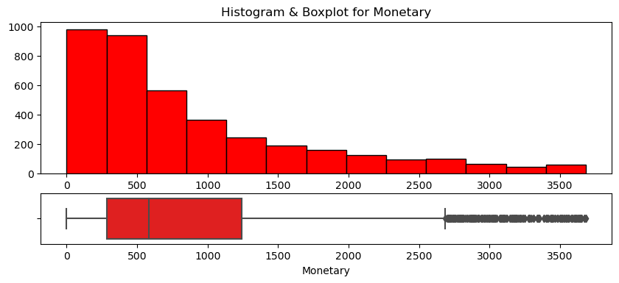
Histogram after removing the outliers from the above graphs.

Slide 10
K-Means Algorithm
Determine the K value
Selection of the centroid
Calculating the distance
Determine the K value
Selection of the centroid
Calculating the distance
K-means is a centroid-based algorithm, or a distance-based algorithm, where we calculate the distances to assign a point to a cluster. In K-Means, each cluster is associated with a centroid.
Elbow Method is method used to determine the optimal value of k.
Based on the Elbow method we decided to take 4 as the k value
We used k-means++ to pick the centroid
Is the distance is minimum?
Is the distance is minimum?
Move to the next cluster
NO
Move to the next cluster
YES
YES
Move to the same cluster
Move to the same cluster
Cluster results
Cluster results

Slide 11
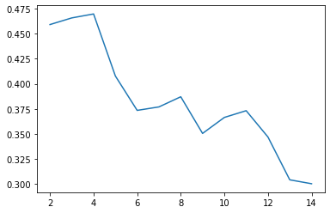
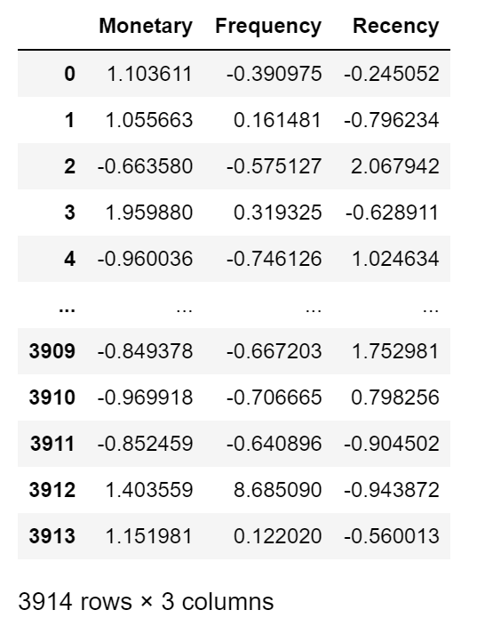
Elbow Method to find the optimal K value
We did Feature scaling, using the standard scaling technique to come together to global centroids faster using the K-Means clustering algorithm.

Slide 12
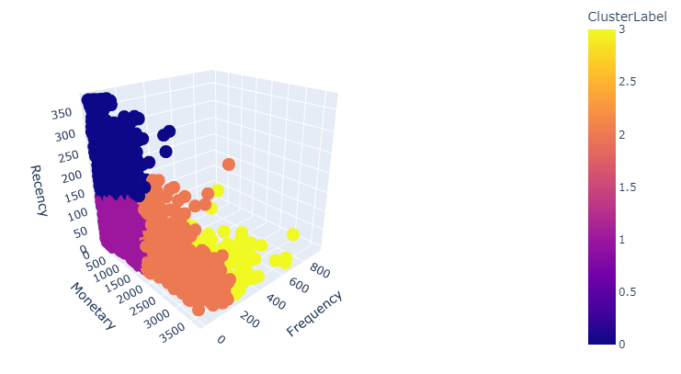
Results & Conclusion
Based on the 4 clusters.
Marketing team can further target the customers
Based on the products they bought, providers can re-stock mall/shop
Attract the old customers who are in cluster 0 with new offers

Slide 13
Topics Worked on by team members
Initial analysis and selection and Data Cleaning – Akhilasri, Santhi.
Exploratory Data Analysis, Model Build – Siva Krishna, Dinesh Datta, Vaishnav.

Slide 14

References
https://www.kaggle.com/code/fabiendaniel/customer-segmentation
https://www.youtube.com/watch?v=1XqG0kaJVHY&t=5s
https://www.analyticsvidhya.com/blog/2019/08/comprehensive-guide-k-means-clustering/
https://medium.com/@evgen.ryzhkov/5-stages-of-data-preprocessing-for-k-means-clustering-b755426f9932

Slide 15

Thank you

